Slide 1

Lecture 1: Becoming a Unicorn
Benjamin Simeon Harvey (Ben)
Adjunct Faculty, CS and EMSE Department
The George Washington University
E-mail: bsharve@gwu.edu
Web: https://bsharvey.github.io/
Benjamin Harvey, Ph.D., EMSE 6992 – Introduction to Data Analytics

Slide 2
I. Introductions
Benjamin Harvey, Ph.D., EMSE 6992 – Introduction to Data Analytics

Slide 3
Introductions
I work for the National Security Agency as a Cryptologic Computer Scientist and Data Scientist
EOD data was 10/09 and started in the Computer Science Development Program (CDP)
Intelligence Community National Counterintelligence and Security Professional Award
Data Scientist for the Corporate Disclosures Action Group
Office of the Director National Intelligence (ODNI) Award for Human Capital
NSA Day of Cyber
I played Division I football and basketball at Mississippi Valley State University
The alma mater of “Jerry Rice” the greatest wide receiver of all time
Benjamin Harvey, Ph.D., EMSE 6992 – Introduction to Data Analytics

Slide 4
Introduction: My background
Undergraduate B.S Degree in Computer Science
Mississippi Valley State University, Itta-Bena, MS
Harvard-MIT Post-baccalaureate in Bioinformatics and Integrative Genomics (BIG) and a fellow at NIH Department of Clinical Research Informatics (DCRI)
MIT-Harvard Health and Science Technology (HST) / i2b2, Cambridge, MA
NIH Clinical Center, Bethesda, MD
M.Sc. In Computer Science, and Ph.D. in Computer Science with a focus in Bioinformatics
Bowie State University, Bowie, MD
Mentors include computer scientists, enterprise architects, cyber security specialists, system engineers, & biostatiscicians (Vince Carey, Ph.D. Creator of R/Bioconductor)
Chief and Lead Data Scientist of the Operations Data Science Hub (ODSH) at NSA
Benjamin Harvey, Ph.D., EMSE 6992 – Introduction to Data Analytics

Slide 5
Introduction (your turn!)
Name
Academic background
Work experience
What are your goals for this class?
How do your experiences shape these goals (e.g. what interested you in this class)?
What does "Big Data" mean to you? (why are you here?)
Something “Cool/Interesting” about yourself
Benjamin Harvey, Ph.D., EMSE 6992 – Introduction to Data Analytics

Slide 6
Agenda
Introductions
Overview of Syllabus and Course Expectations
Course Core Topics and Lectures: Becoming a Unicorn
Data Science and Big Data Foundations
Data Science and Big Data and Technology Concepts
Data Science and Big Data Analysis
Advanced Data Science Analytics and Big Data Analysis
Real World Examples
In-class discussion:
What is Data Science (EDA and Data Science Process)?
What is Big Data?
Data Science and Big Data Foundations
Lab
Benjamin Harvey, Ph.D., EMSE 6992 – Introduction to Data Analytics

Slide 7
II. Syllabus and Course Expectations
Benjamin Harvey, Ph.D., EMSE 6992 – Introduction to Data Analytics

Slide 8
Course Outcomes
Core Topic 1: Fundamentals of Data Science and Big Data
Explain Big Data from a business and technology perspective, along with an overview of common benefits, challenges, and adoption issues.
Data Science Roadmap and Big Data Life Cycle
Review of Computer Science and Linear Algebra
Core Topic 2: Data Science & Big Data Analysis Technology Concepts
Apply contemporary analysis practices, technologies and tools within Big Data environments through programming and at a conceptual level
Know the common analysis functions and features offered by Big Data software solutions, as well as a high-level understanding of the back-end components that enable these functions.
Data Engineering and Data Munging
Data Visualizations
Big Data and Database Storage Technology
Benjamin Harvey, Ph.D., EMSE 6992 – Introduction to Data Analytics

Slide 9
Course Outcomes
Core Topic 3: Big Data Analysis and Science
Knowledge of probability & statistics, modeling, and analysis techniques for data patterns, clusters, classification, and text analytics, as well as the identification of outliers and errors that affect the significance and accuracy of predictions made on Big Data datasets.
Machine Learning and Classification
Unsupervised Learning and Regression
Data Analysis 1: AI and NLP, 2: Time Series, and 3: Prob & Stats and Maximum Likelihood
Core Topic 3: Advanced Big Data Analysis and Science
Apply the learned topic areas and analysis techniques to Big Data with an emphasis on how advanced analysis and analytics need to be carried out individually and collectively in support of the distinct characteristics, assess requirements and challenges associated with Big Data datasets.
Stochastic Modeling and Advanced Classifiers
Graph Analytics and Recommender Systems
Benjamin Harvey, Ph.D., EMSE 6992 – Introduction to Data Analytics

Slide 10
Assignments - Portfolio Project (50%)
In this class you will create a (1) Data Science portfolio and (2) “ToolKit”
The goal is to consolidate learning materials, assignments, and Data Science tools within a portfolio for displaying your skillset to colleagues and potential employers and future tool use.
Assignment 1 and Labs – Creating a Portfolio: Intro to GitHub and R/Python and EDA
Assignment 2 and Labs - Statistical Inference
Assignment 3 and Labs- Machine Learning
Assignment 4 and Labs – Use the Data Science Process (DSP) to analyze a selected Big Data set and then visualize, interpret, and communicate your results in your Portfolio. Essentially, document you research project in your portfolio
Students will choose a dataset based upon their research interests, things that inspire them, or something we discussed in class.
Detail your steps in developing your solution, including how you collected the data, alternative solutions you tried, describing statistical methods you used, and the insights you obtained in your portfolio.
Benjamin Harvey, Ph.D., EMSE 6992 – Introduction to Data Analytics
Notes:
http://kbroman.org/simple_site/pages/user_site.html

Slide 11
Student Final Project (50%)
Final projects are to be done in either teams or as an individual
Each team will present a talk (e.g., PowerPoint or other technique)
Each team will produce a written document
5 pages long, formatted according to IEEE style
Points will be withheld if the document is not formatted appropriately
Peer evaluations will be factored in the determination of the term project grade.
Final projects should use at least one of the techniques covered in class and from the assignments
Final projects will be placed in your final portfolio (as well as Assignment 4)
This is a significant part of your grade. Choose your problem early.
Benjamin Harvey, Ph.D., EMSE 6992 – Introduction to Data Analytics

Slide 12
Student Final Project Format (50%)
Research Proposal – Due 10/4
Overview, and Motivation: Provide an overview of the project goals and the motivation for it. Consider that this will be read by people who did not see your project proposal.
Related Work: Anything that inspired you, such as a paper, a web site, or something we discussed in class.
Initial Questions: What questions are you trying to answer? How did these questions evolve over the course of the project? What new questions did you consider in the course of your analysis? - Data: Source, scraping method, cleanup, storage, etc.
Final Paper (also includes Abstract, Overview, Motivation, Related Work, Initial Questions and Data from the Research Proposal):
Exploratory Data Analysis: What visualizations did you use to look at your data in different ways? What are the different statistical methods you considered? Justify the decisions you made, and show any major changes to your ideas. How did you reach these conclusions?
Final Analysis: What did you learn about the data? How did you answer the questions? How can you justify your answers?
Presentation: Present your final results in a compelling and engaging way using text, visualizations, images, and videos on your project web site.
Benjamin Harvey, Ph.D., EMSE 6992 – Introduction to Data Analytics

Slide 13
Academic Integrity
Plagiarism is a direct violation of the GW Code of Academic Integrity which you and I have both agreed to.
Course policy:
1st violation of academic integrity will result in a warning consisting of a loss of points equal to the value of the plagiarized assignment.
A plagiarized homework assignment will be given a score of -5% of your total grade (equivalent to getting zero on two assignments)
A plagiarized exam is equivalent to a zero on two exams.
A plagiarized final project is equivalent to -40% of your grade and is a practical failure of the course.
2nd violation of academic integrity will result in a complaint filed in the Office of Academic Integrity with a recommended MINIMUM sanction of failure of the course.
No exceptions
If you are unsure if your work is plagiarized, ask me before you turn it in.
Plagiarism will not be tolerated.
If you feel that you have been incorrectly accused of plagiarism, you may appeal to the GW Committee on Academic Integrity and a hearing will be held.
Benjamin Harvey, Ph.D., EMSE 6992 – Introduction to Data Analytics

Slide 14
II. Becoming a Unicorn

Slide 15
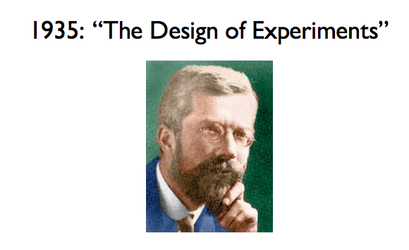
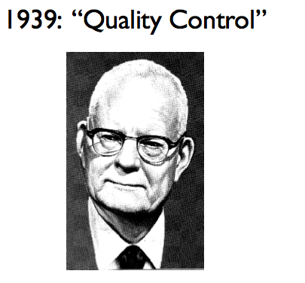
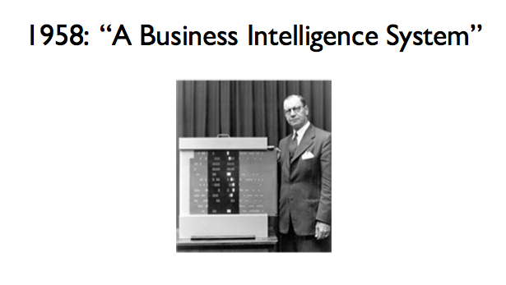
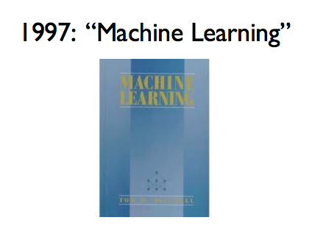
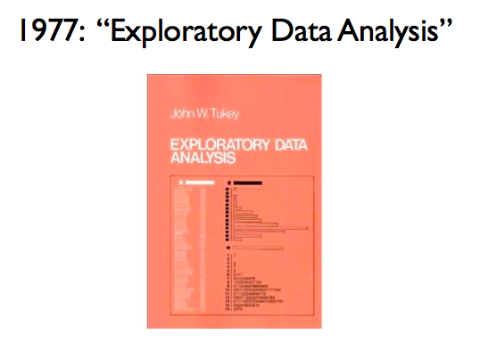
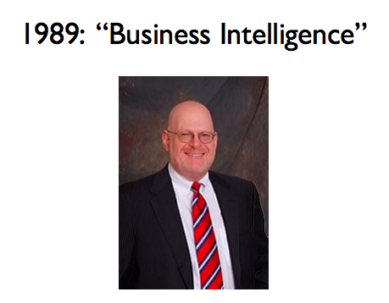
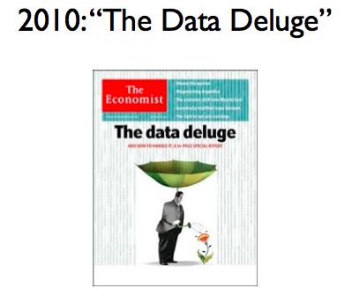
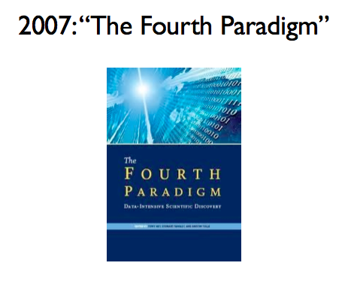
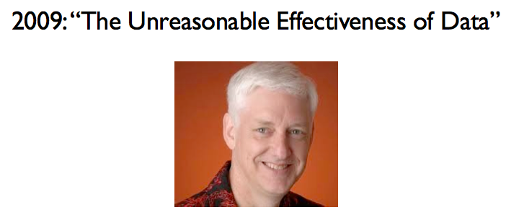
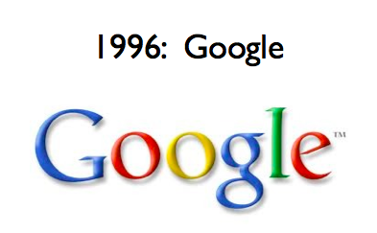
Data Analysis Has Been Around for a While
R.A. Fisher
W.E. Demming
Peter Luhn
Howard
Dresner
Abridged Version of Jeff Hammerbacher’s timeline for CS 194, 2012
Notes:
Fisher: ANOVA, Fisher’s exact test.
Also credited with quote “correlation does not imply causation” – lifetime pipe smoker, he derided papers showing a link between smoking and cancer.
Denning – quality control – statistical sampling
Luhn – indexing, IR principles – use text and data to inform Business Decisions
Tukey – exploratory data analsysi – led to S, S+ and R
Howard Dresner – modern proponent of BI
Tom Mitchell’s ML book – still a best-seller
Fourth Paradigm – data driven science – inspired by Jim Gray’s work.
Peter Norvig – simple models + lots of data > complex models
Data Deluge – exponential growth in data volume

Slide 16
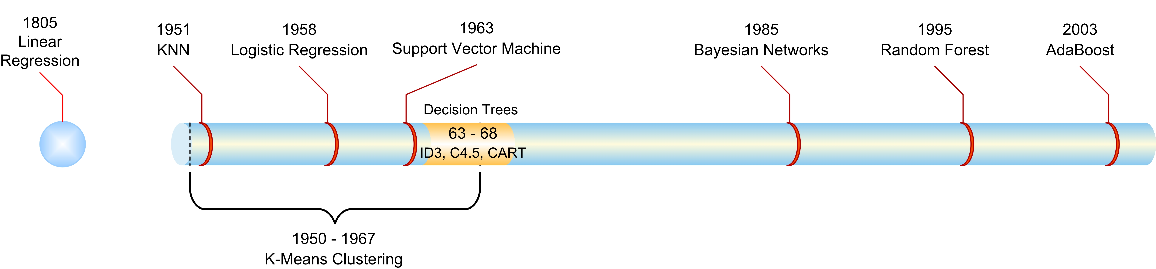
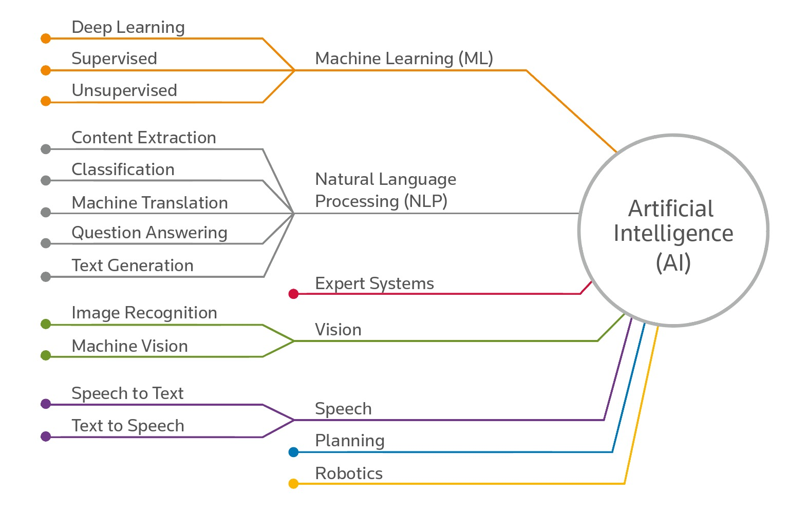
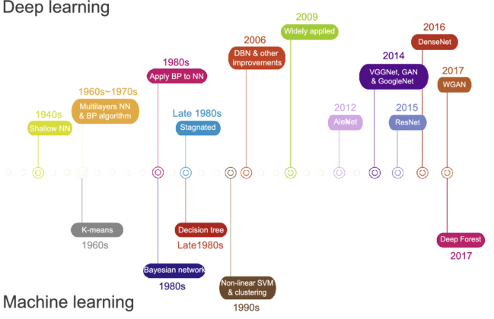
Where are we headed?

Slide 17
ML/AI Augmentation

Slide 18
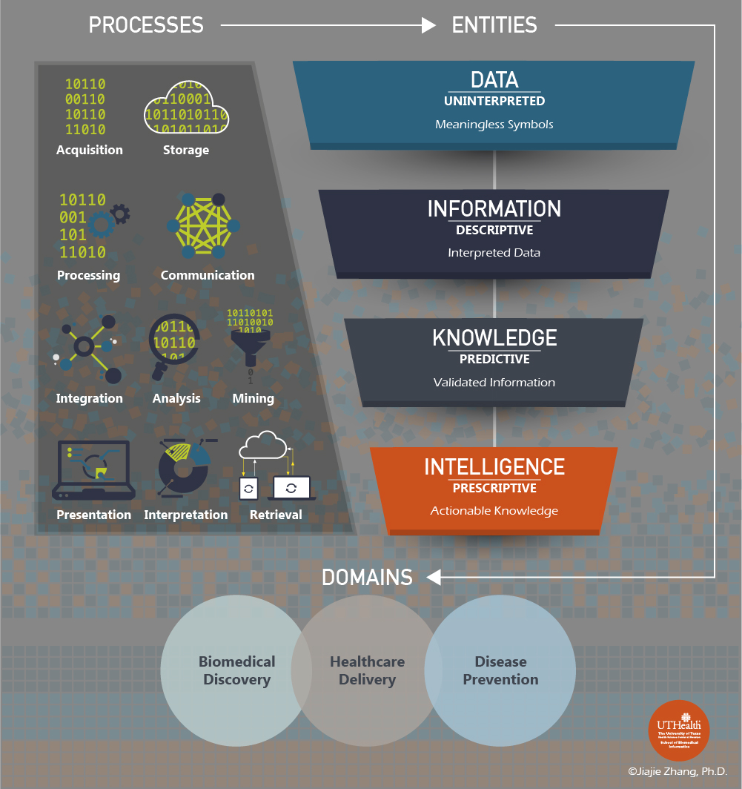
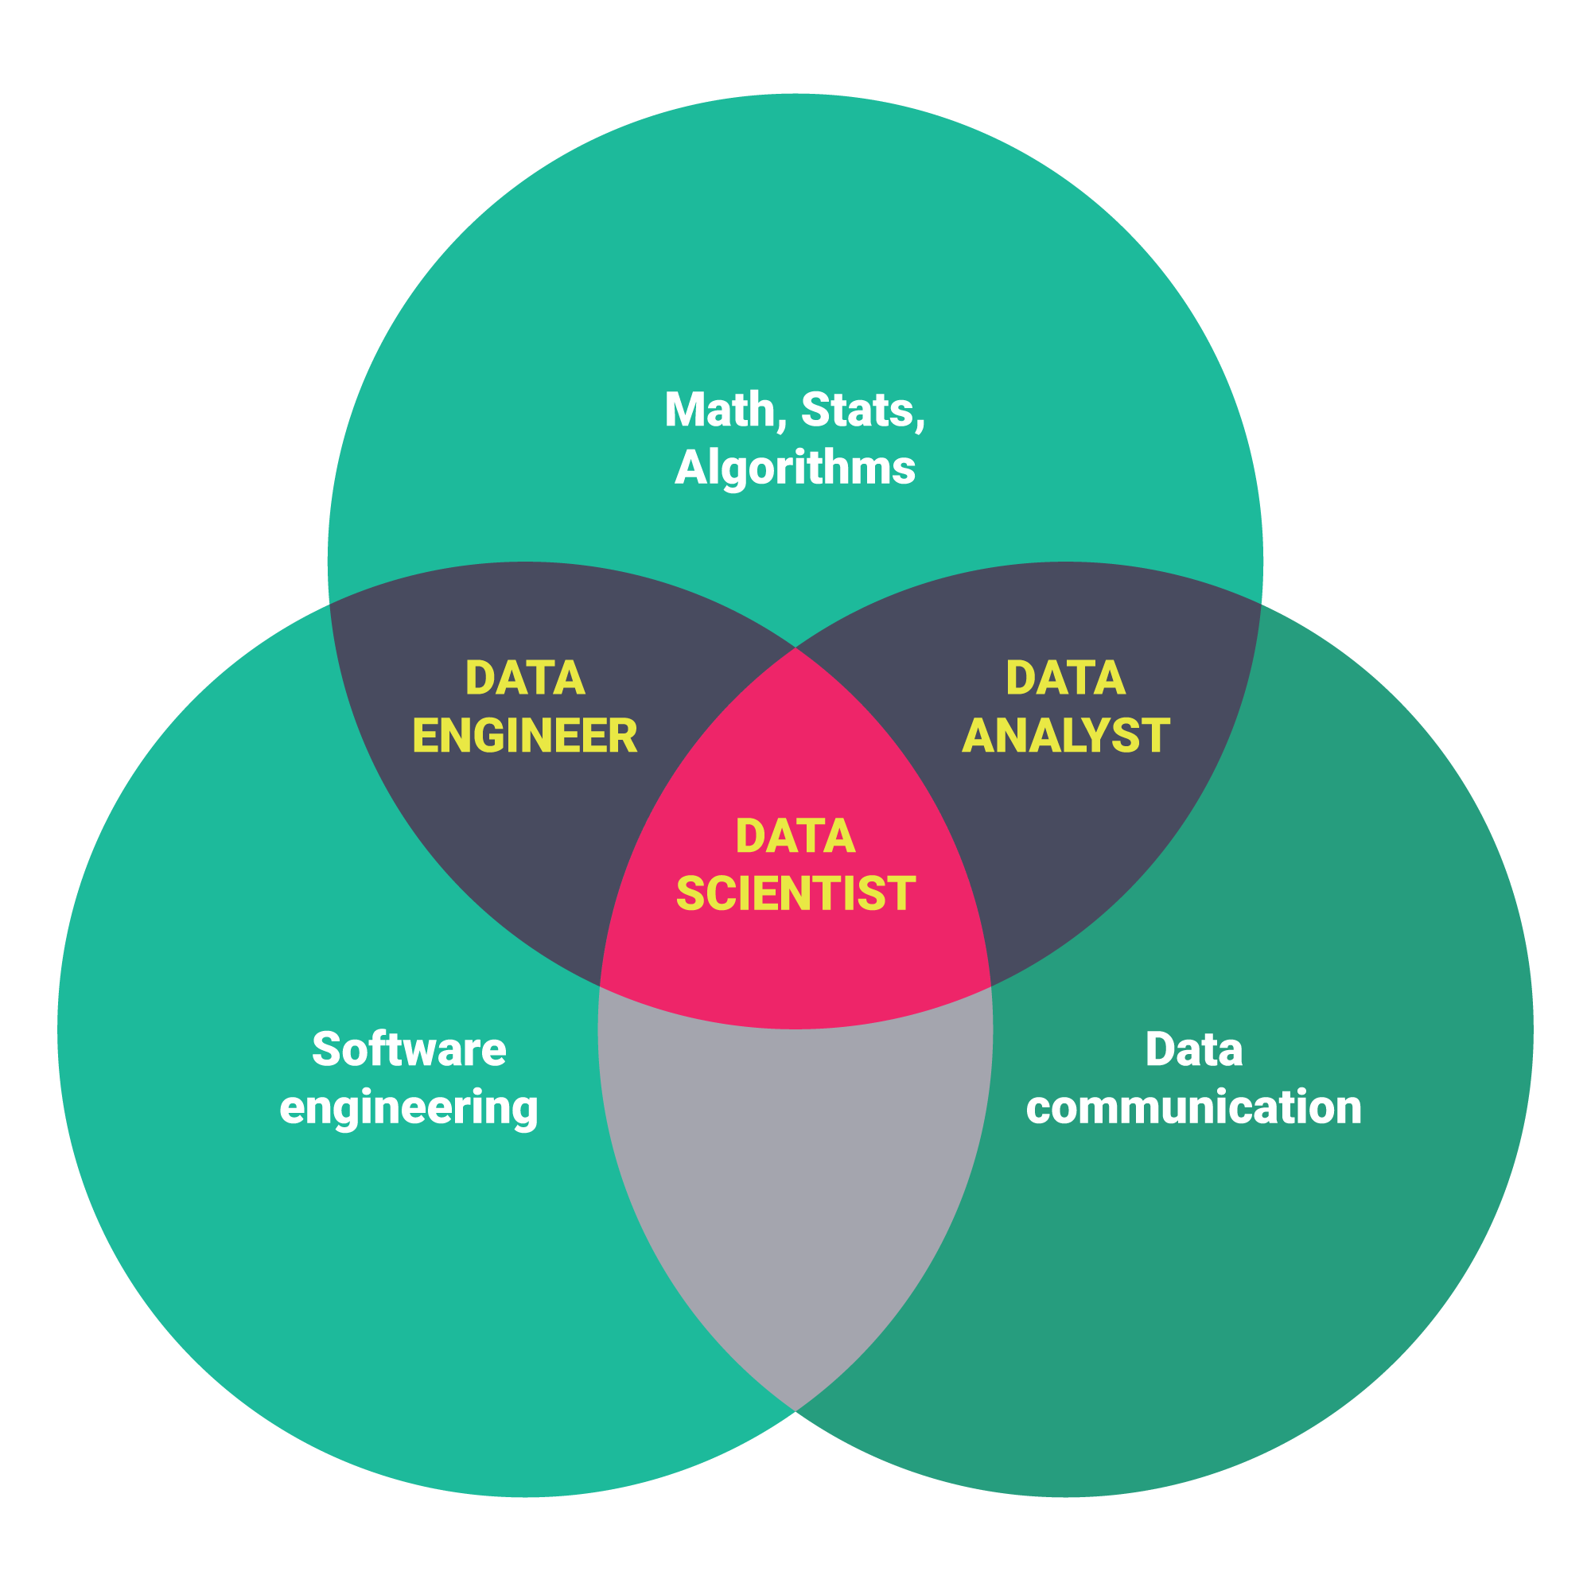
Statistician/Informatician Vs. Data Scientist
Computer Science
Visualization and SME

Slide 19
Becoming A Unicorn
Data science means doing analytics work that, for one reason or another, requires a substantial amount of computer science (CS) and software engineering skills.
Data Engineering, Visualization, Integration
It’s very hard to find people who can construct good statistical models, understand software/programming languages/architecture/frameworks, and relate this all in a meaningful way to business problems.
Integration: A unicorn can take a data, analyze it, visualize it, and take the data science product and integrate it into existing or future architecture.

Slide 20
Steps to Becoming a Unicorn
Understand each stage of Data science process and Big Data Analytics life cycle
Principles of Programming Languages
Understand Software Engineering Life Cycle
Understand Data Engineering and Munging
Become an expert in Data Analytics, modeling, ML, AI
Start exploring advanced analytics
Understand Big Data analytics and Architectures
Understand Data Visualization and Representation

Slide 21
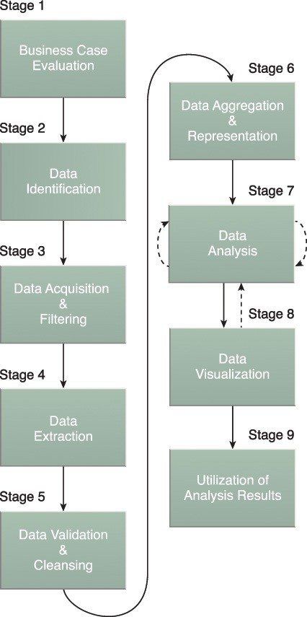
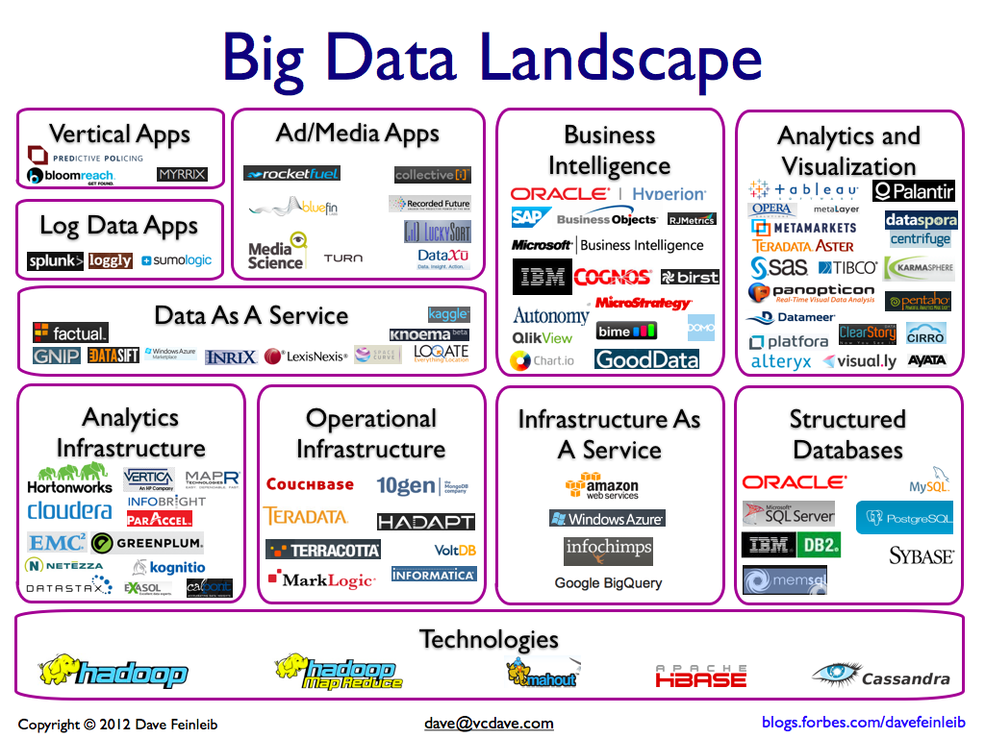
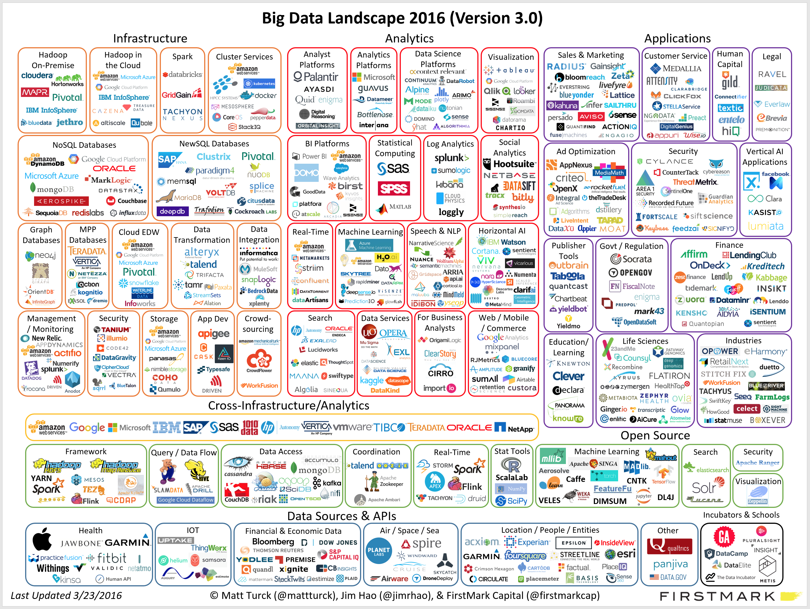
Big Data Analytics Life Cycle
Aggregation and Representation
Data Science Analysis
Visualization and Interpretation
Utilization and Operationalization of Results
Munging
Operational Data
Business Case Evaluation
Data Identification
Acquisition and
Filtering
Validation and Cleansing
Evaluation
Infrastructure:
- Storage
- Processing
- Analytics
Infrastructure:
- Storage
- Processing
- Analytics

Slide 22
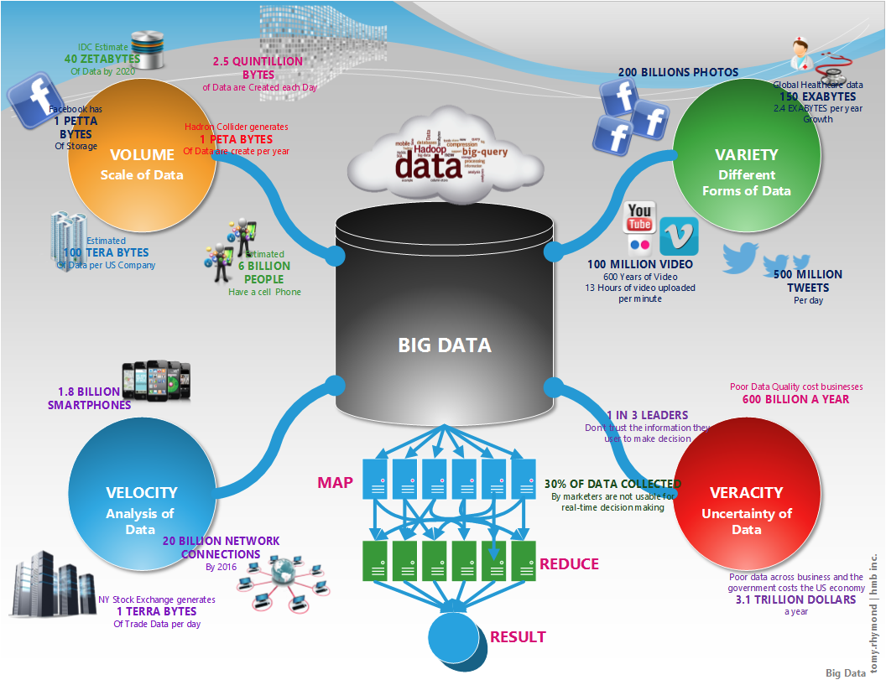
What is Big Data?
Big Data
Analytics

Slide 23

III. Motivational Examples
17
Benjamin Harvey, Ph.D., EMSE 6992 – Introduction to Data Analytics

Slide 24
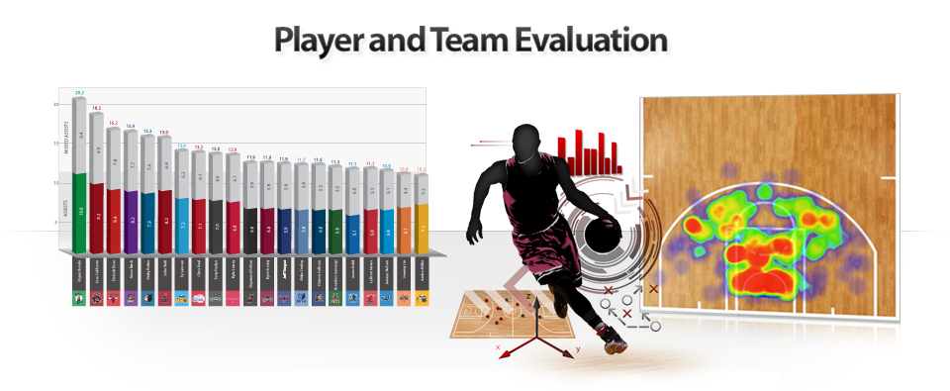

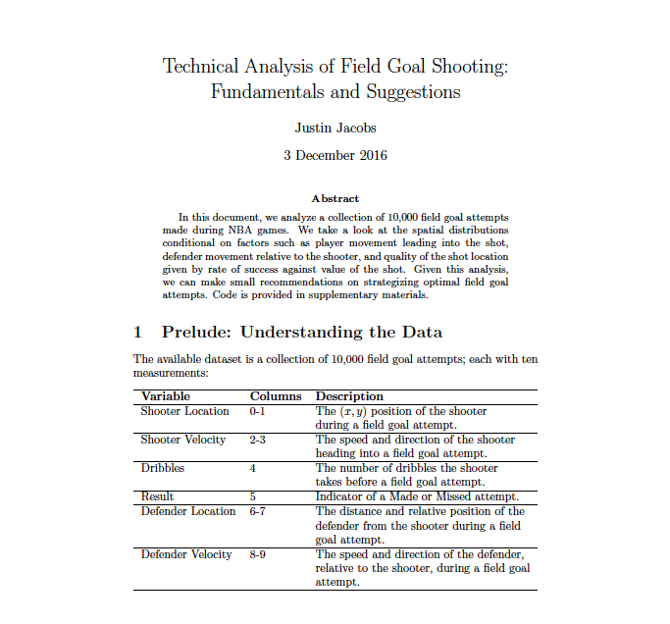
Sports Big Data Analytics
"Please help us identify opportunities to impact decision making by modeling and understanding field goal percentage. Select an opportunity and tailor your analysis accordingly. You will be provided a dataset on which you should base your work. The accompanying 15 GB file contains 100,000,000 rows, each corresponding to a shot attempt. There are 9 fields: shot_x_location, shot_y_location, shooter_velocity_ft_set, shooter_angle, dribbles_before, made, defender_distance, defender_angle, defender_velocity_ft_sec. Please help by submitting unique solutions. Include and describe a visualization and deliver the code through one of the appropriate cloud storage platforms below."

Slide 25
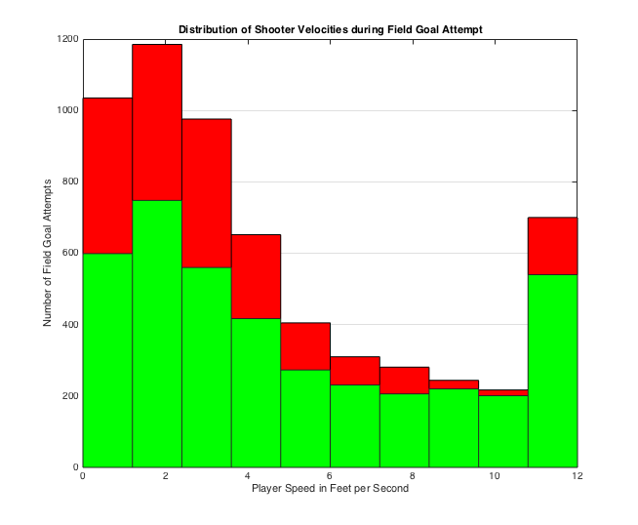
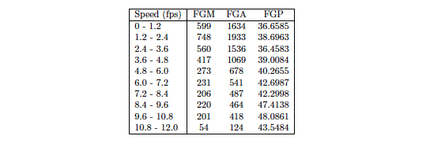
Sports Big Data Analytics
Distribution of Shooter Velocities during Field Goal Attempts
Number of Field Goal Attempts
Player Speed in Feet per Seconds

Slide 26
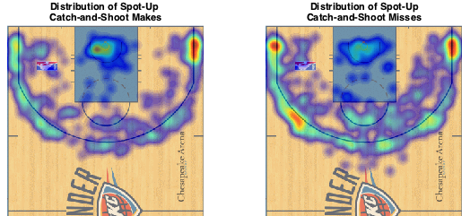
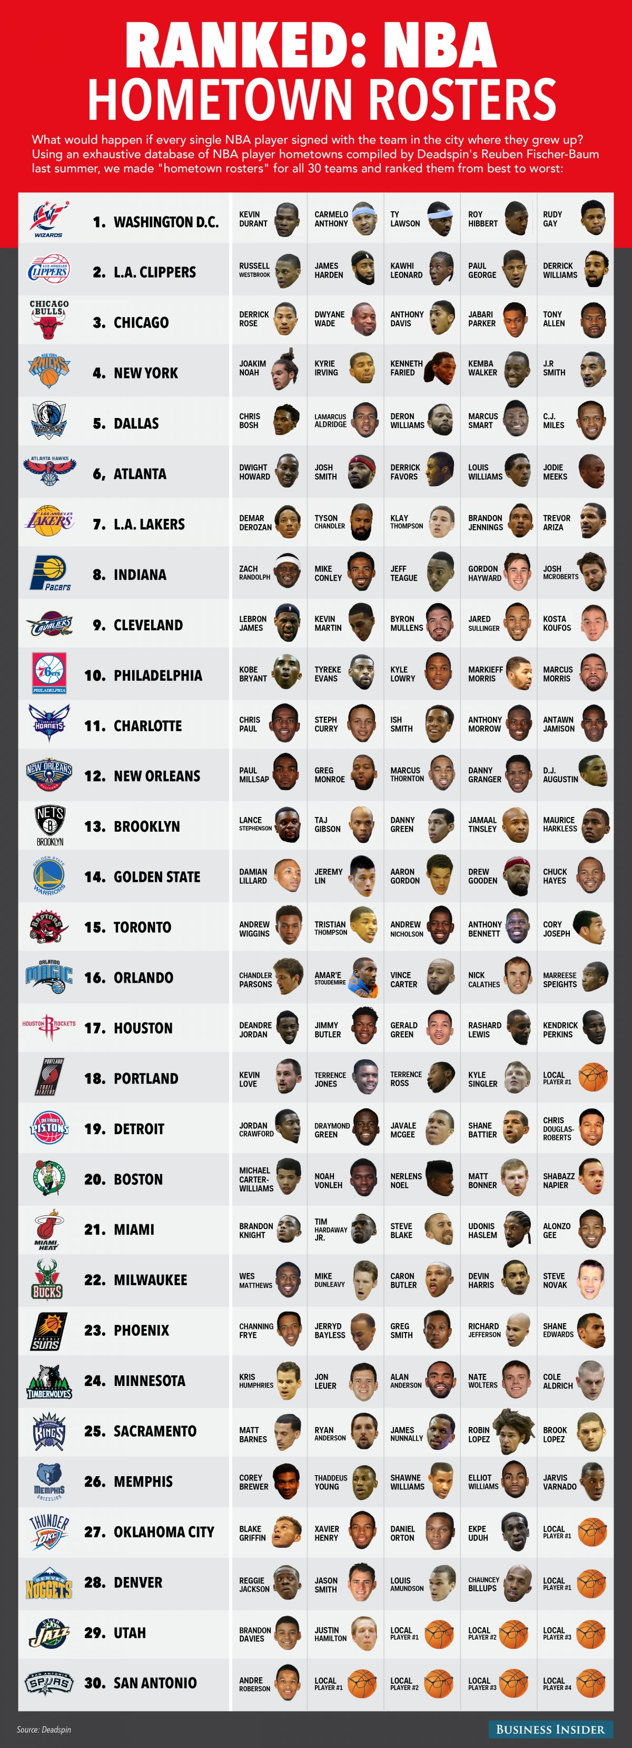
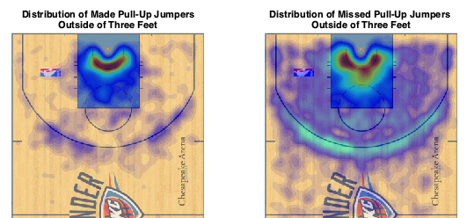

Slide 27
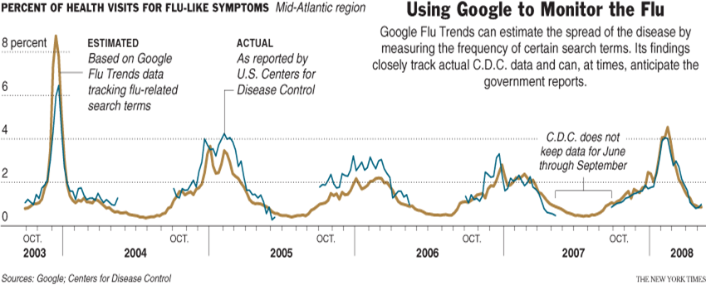
Using Google to Monitor the Flu
Benjamin Harvey, Ph.D., EMSE 6992 – Introduction to Data Analytics

Slide 28
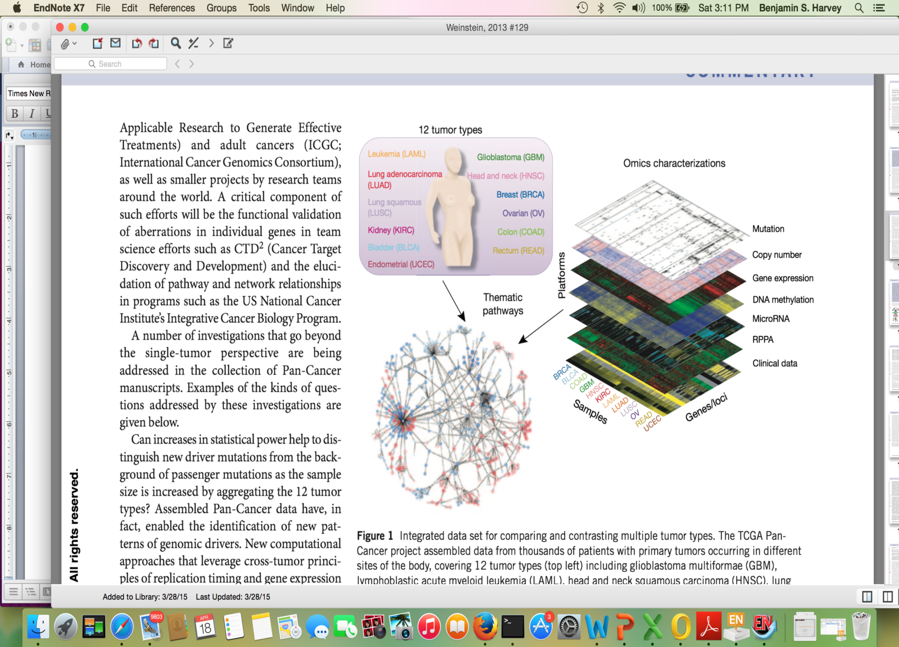
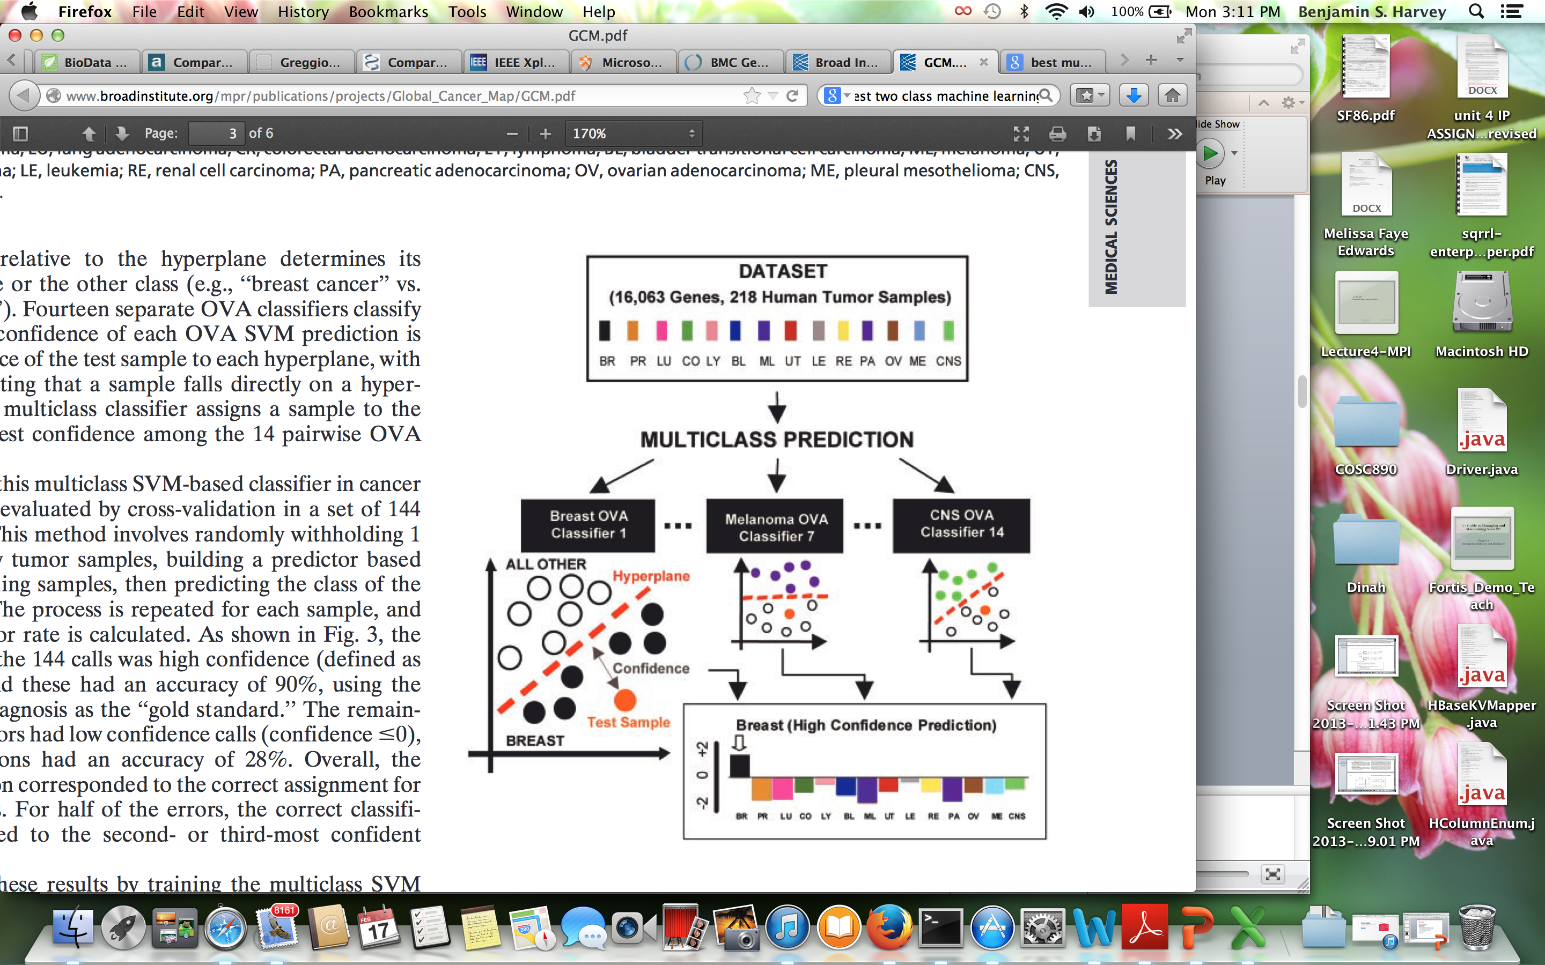
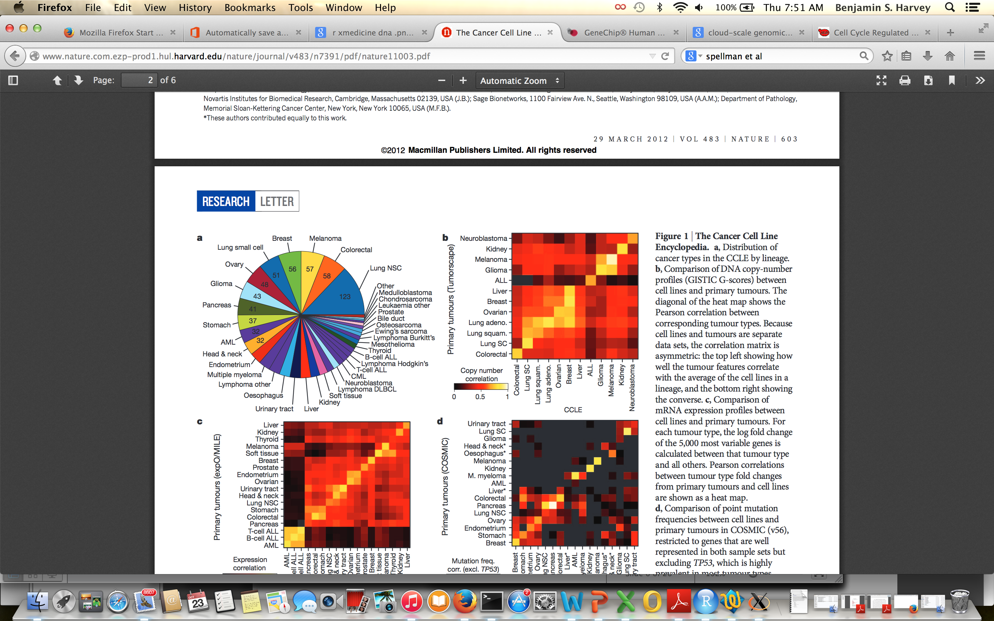
Large-Scale Cancer Genomics (10MB per Sample – 10’s of GBs per dataset)
Global Cancer Map (GCM) Data: 218 tumor samples, spanning 14 common tumor types, and 90 normal tissue samples to oligonucleotide microarray gene expression analysis:
16,063 genes
The Cancer Genome Atlas: DNA methylation is an epigenetic mark which can be associated with transcriptional inactivity when located in promoter regions. Ovarian cancer study for gene expression and methylation correlated values for 22,000 genes across 598 samples
218 Tumor Samples and 16,6063 genes
Cancer Cell Line Encyclopedia (CCLE) : a compilation of gene expression, chromosomal copy number and massively parallel sequencing data from 947 human cancer cell lines. coupled with pharmacological profiles for 24 anticancer drugs across 479 of the cell lines: 18,897 genes
Benjamin Harvey, Ph.D., EMSE 6992 – Introduction to Data Analytics

Slide 29

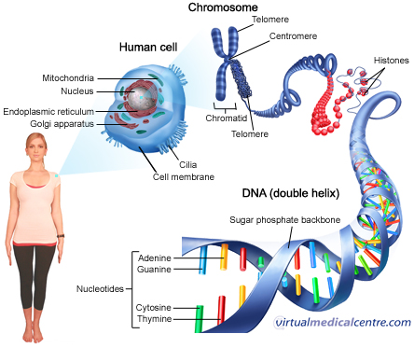
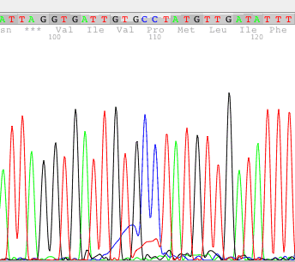


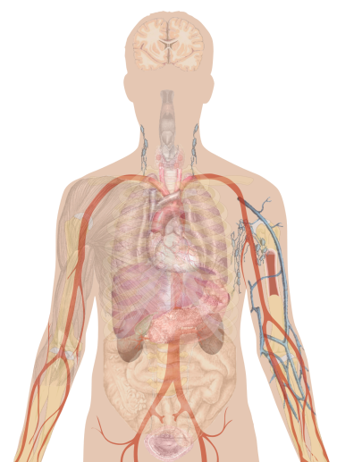
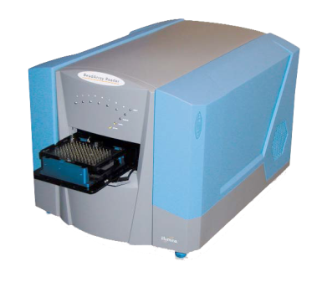
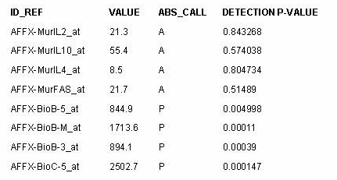
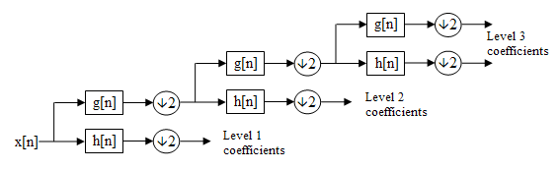
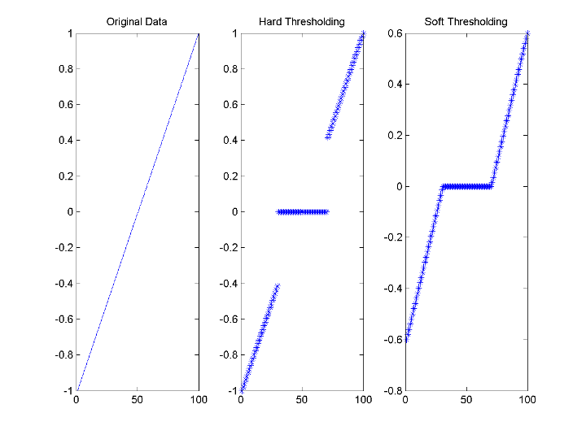
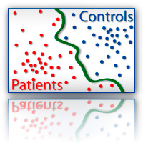
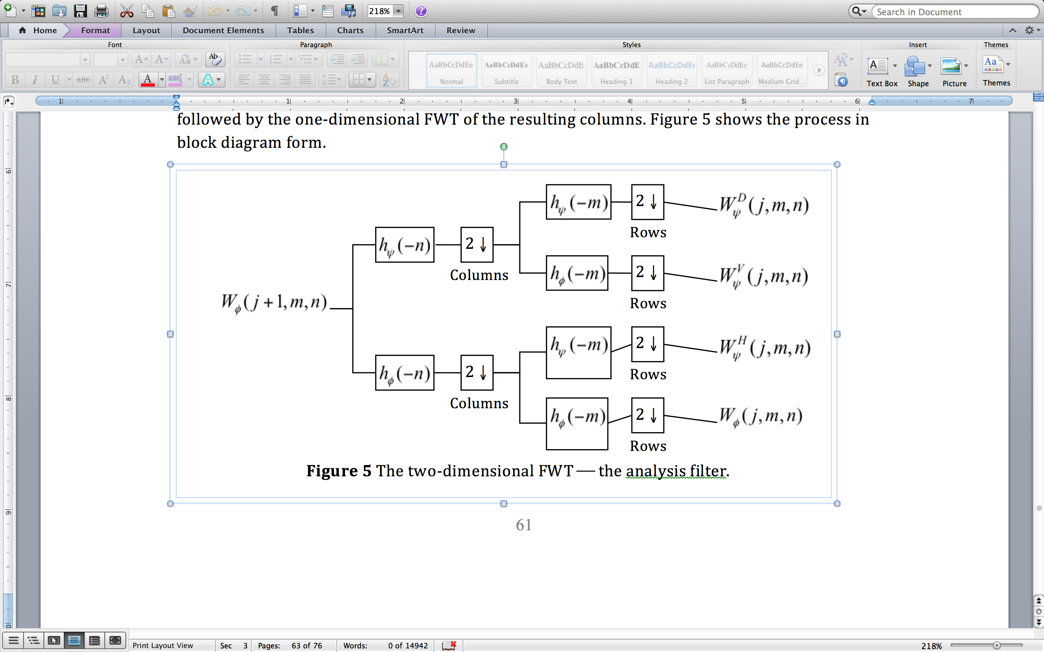
GENOMIC SIGNAL PROCESSING ANALYSIS
Genomic Signal Processing: is a genomic data mining process which involves uncovering patterns, associations, anomalies, and statistically significant structures and events in genetics and genomics data
Data Fusion and Sampling
Data Storage, Integration, and Representation
Data Management
Data PreProcessing
Data Mining Algorithm
Data Post-Processing
1D
2D
Signal Pre-Processing
Denoising & Feature Extraction
Classification and Validation
1D
2D
Benjamin Harvey, Ph.D., EMSE 6992 – Introduction to Data Analytics

Slide 30
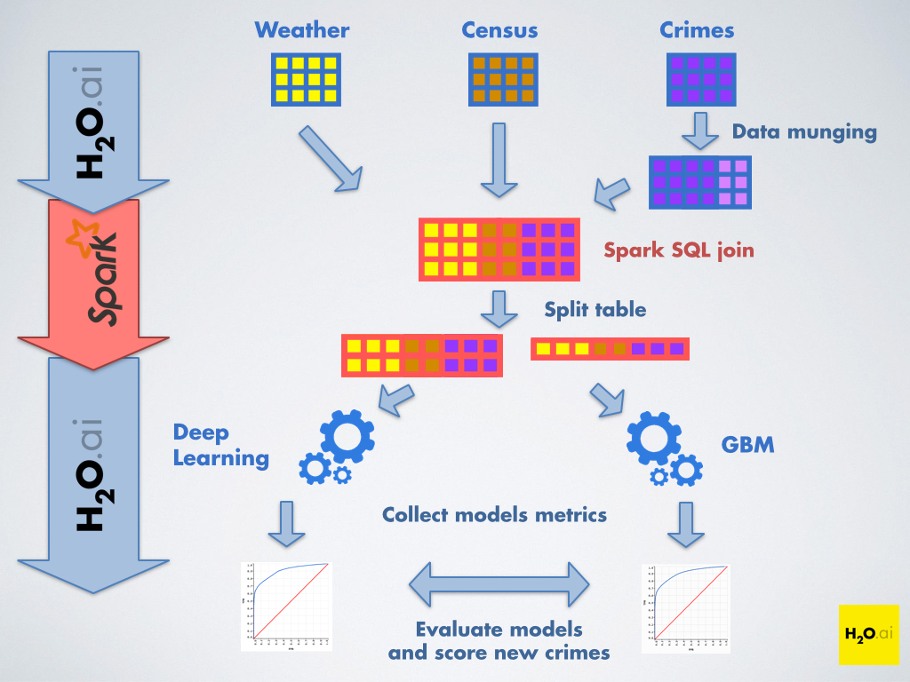
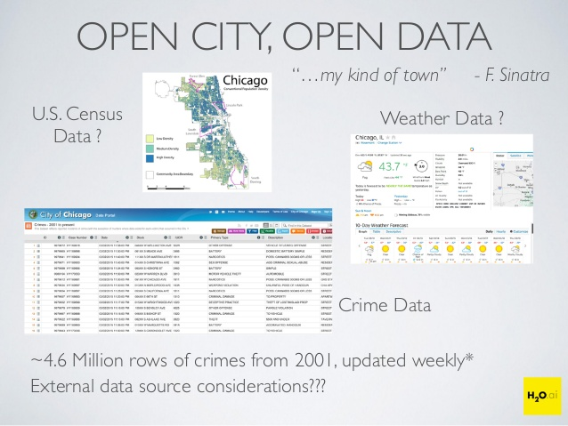
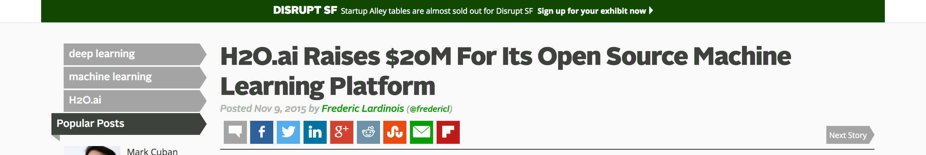
H₂O ai and Crime Prediction
Benjamin Harvey, Ph.D., EMSE 6992 – Introduction to Data Analytics

Slide 31
IV. What is Big Data?
Benjamin Harvey, Ph.D., EMSE 6992 – Introduction to Data Analytics

Slide 32
What is Big Data?
Benjamin Harvey, Ph.D., EMSE 6992 – Introduction to Data Analytics

Slide 33
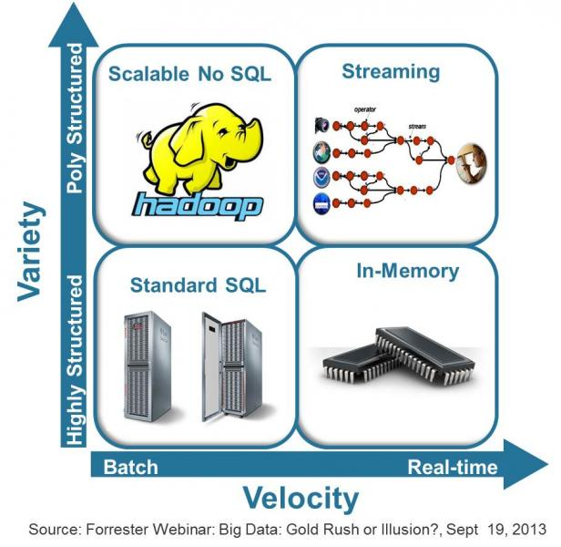
What’s NOT Big Data?
Benjamin Harvey, Ph.D., EMSE 6992 – Introduction to Data Analytics

Slide 34
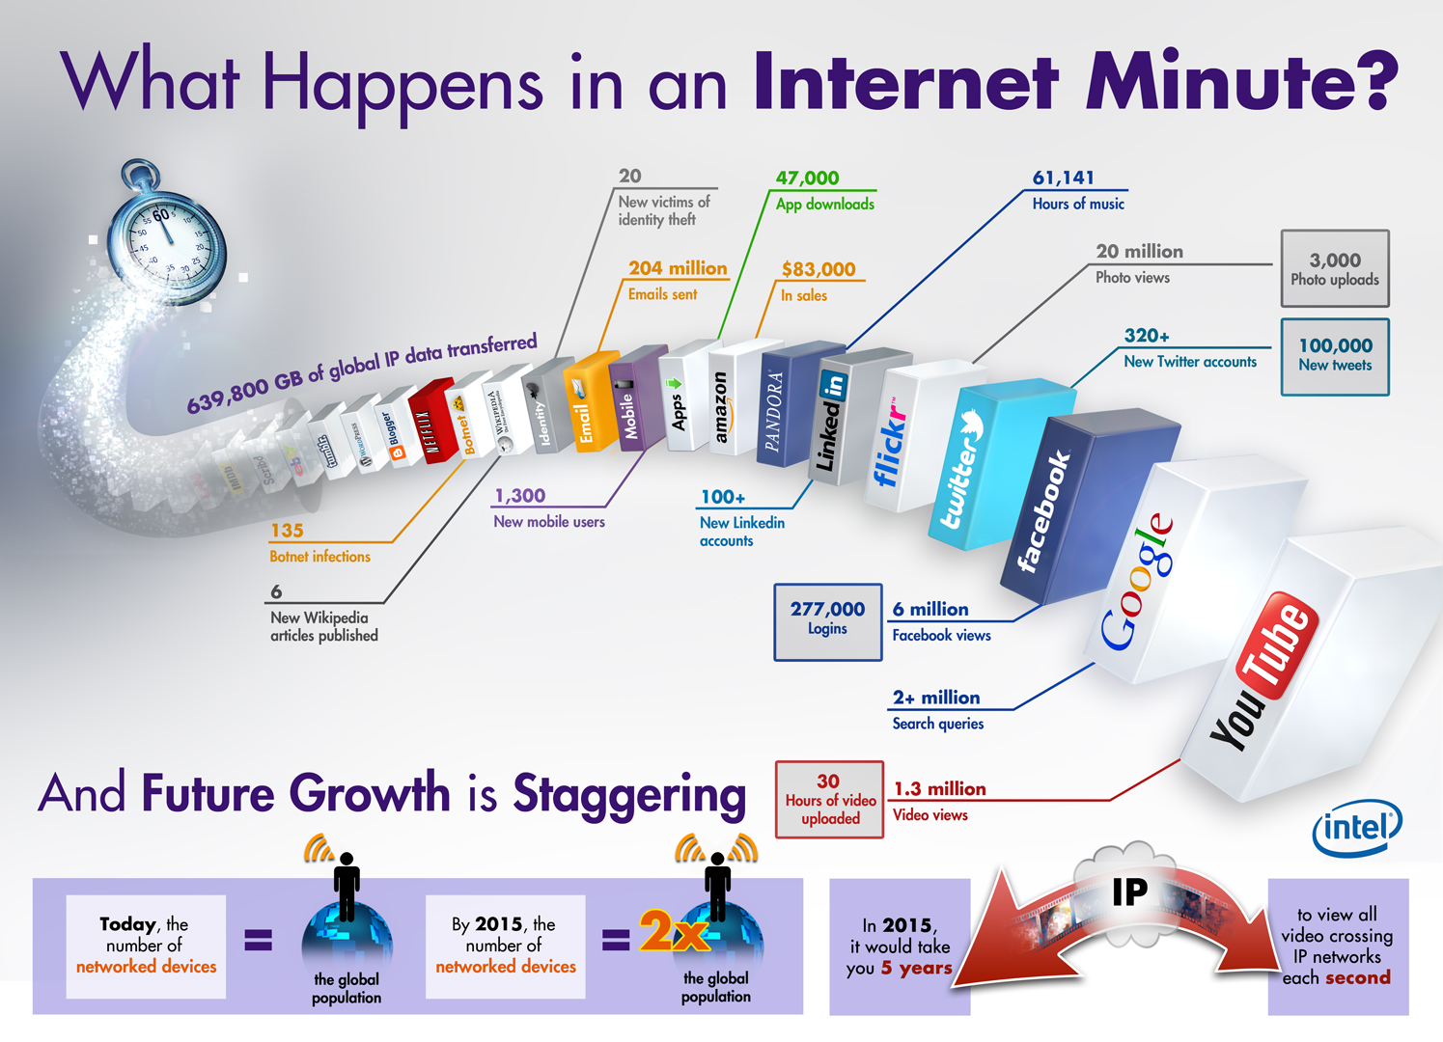
60 Second Data Analysis
Benjamin Harvey, Ph.D., EMSE 6992 – Introduction to Data Analytics

Slide 35
Big Data Landscape - 2012
the companies are expanding as fast as the data!
Benjamin Harvey, Ph.D., EMSE 6992 – Introduction to Data Analytics
Notes:
http://www.cs.ucl.ac.uk/staff/D.Jones/t42morph.html
This animated GIF image shows a synthetic folding trajectory for a small alpha-helical protein (porcine NK-lysin) which was predicted using our FRAGFOLD software as part of the 2nd CASP experiment carried out in 1996. This was the first successful prediction of a novel protein fold in CASP and was also notable as being the first fold prediction method to employ fragment assembly. The basic idea of fragment assembly is to take fragments of already known protein structures and to recombine them randomly to create possible new protein folds. See the following reference for more details:Jones, D.T. (1997) Successful ab initio prediction of the tertiary structure of NK-Lysin using multiple sequences and recognized supersecondary structural motifs. PROTEINS. Suppl. 1, 185-191.

Slide 36
Big Data Landscape - 2017
Benjamin Harvey, Ph.D., EMSE 6992 – Introduction to Data Analytics

Slide 37


















DATA
CLOUD
STORAGE
CLOUD
Amazon Elastic Elastic MapReduce (EMR)
Amazon Simple Storage Service (S3)
Utility
CLOUD
UTILITY
CLOUD
Data Cloud History
Amazon Elastic Compute Cloud (EC2)
MapReduce
File System
Benjamin Harvey, Ph.D., EMSE 6992 – Introduction to Data Analytics

Slide 38
IV. What is Data Science
Benjamin Harvey, Ph.D., EMSE 6992 – Introduction to Data Analytics

Slide 39
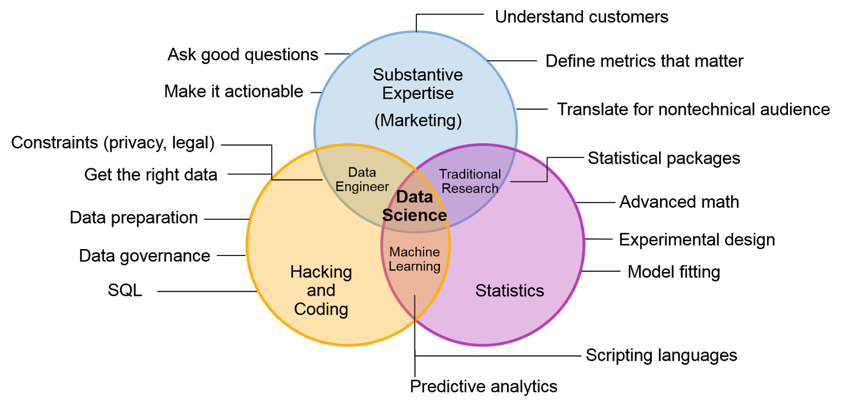
Data Science Venn Diagram
Computer Architecture
Benjamin Harvey, Ph.D., EMSE 6992 – Introduction to Data Analytics

Slide 40
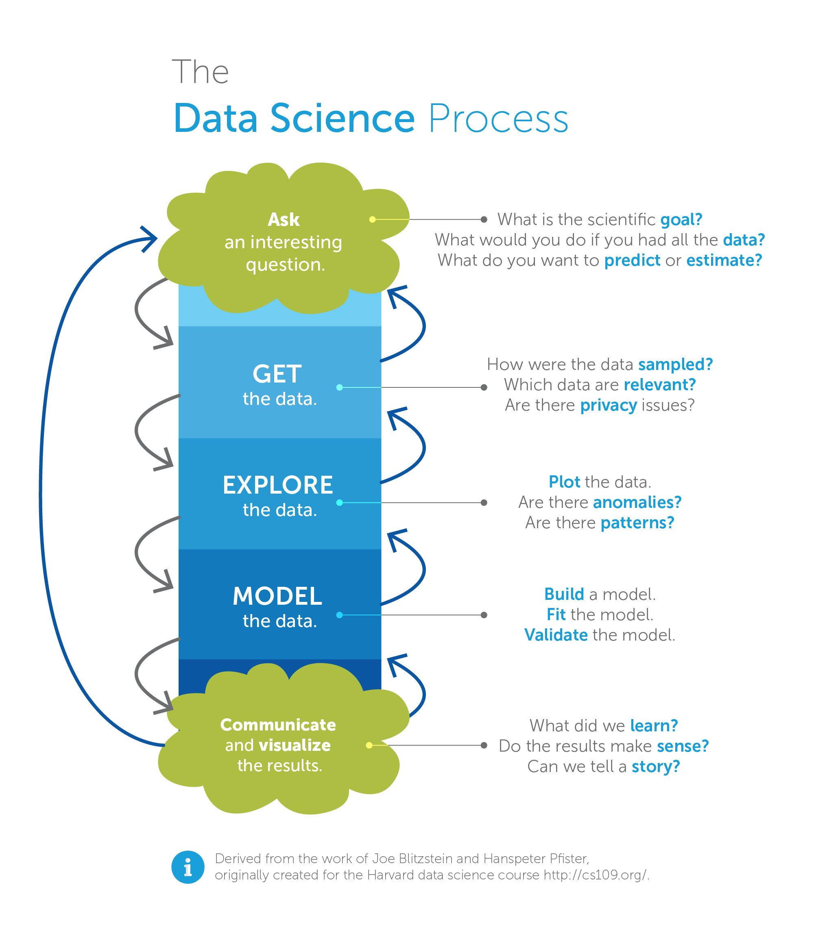
Data Science Process
Benjamin Harvey, Ph.D., EMSE 6992 – Introduction to Data Analytics

Slide 41









Data Mining
Analytics
use
Data Warehouse
are comprised of
uses
uses data stored in
is closely related to
automate
interfaces with/ provides
analyze
Machine Learning
Data Analytics
Business Intelligence
OLAP
uses
uses
is a type
is a type of
reports
feeds data into
of
Quantitative Analysis
Quantitative Analysis
KPIs
ETL
uses
OLTP
is used for
is used for
Commodity Hardware
generally uses
Big Data Solution
can process
is an open-source implementation of
provides storage for
Large Datasets
Hadoop
NoSQL Databases
Benjamin Harvey, Ph.D., EMSE 6992 – Introduction to Data Analytics

Slide 42
Discussion
What is Data Science to you?
Provide an example.
What is ”Big Data” to you?
Provide an example.
Benjamin Harvey, Ph.D., EMSE 6992 – Introduction to Data Analytics

Slide 43




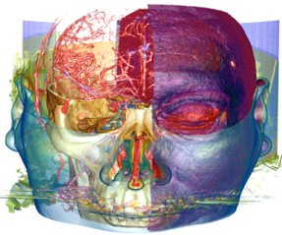




Summary: What is Data Science? What is Big Data?
Data Science: To gain insights through computation, statistics, and visualization
In this course, you will learn four core topics that have been associated with Data Science
Data Science and Big Data Foundations, Big Data and Technology Concepts, Big Data Analysis and Science, Advanced Big Data Analysis and Science
The definition of Big Data is subjective and really depends of the following:
Volume, Velocity, Veracity, Variety of data
Current CPU capacity
Benjamin Harvey, Ph.D., EMSE 6992 – Introduction to Data Analytics

Slide 44
IV. Foundations of Big Data
Benjamin Harvey, Ph.D., EMSE 6992 – Introduction to Data Analytics

Slide 45
Agenda
Concepts and Terminology
Datasets
Data Analysis
Types of Data Analytics
Descriptive Analytics, Diagnostic Analytics, Predictive Analytics, Prescriptive Analytics
Business Intelligence (BI)
Key Performance Indicators (KPI)
Big Data Characteristics
Volume, Velocity, Variety, Veracity, Value
Different Types of Data
Structured Data
Unstructured Data
Semi-structured Data
Metadata
Lab
Benjamin Harvey, Ph.D., EMSE 6992 – Introduction to Data Analytics

Slide 46
Concepts and Terminology
Data Analysis
Data analysis is the process of examining data to find facts, relationships, patterns, insights and/or trends. The overall goal of data analysis is to support better decision making.
Data Analytics
Data analytics is a discipline that includes the management of the complete data lifecycle, which encompasses collecting, cleansing, organizing, storing, analyzing and governing data.
Big Data Analytics
The lifecycle generally involves identifying, procuring, preparing and analyzing large amounts of raw, unstructured data to extract meaningful information that can serve as an input for identifying patterns, enriching existing enterprise data and performing large-scale searches.
Data analytics enable data-driven decision-making with scientific backing so that decisions can be based on factual data and not simply on past experience or intuition alone.
descriptive analytics
diagnostic analytics
predictive analytics
prescriptive analytics
Benjamin Harvey, Ph.D., EMSE 6992 – Introduction to Data Analytics

Slide 47
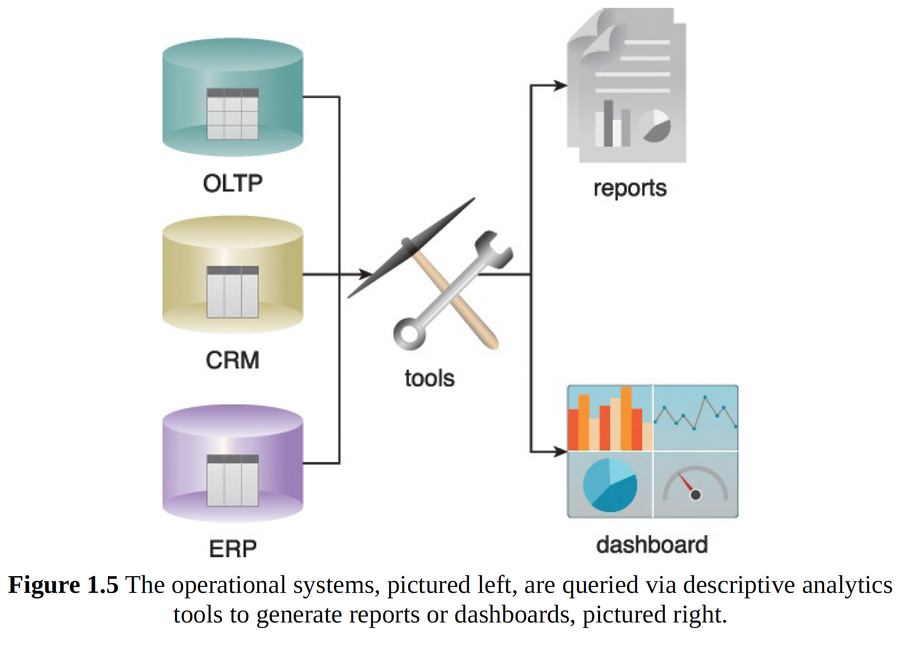
Concepts and Terminology
Descriptive Analytics
Descriptive analytics are carried out to answer questions about events that have already occurred.
Erl, Thomas, Wajid Khattak, and Paul Buhler. Big data fundamentals: concepts, drivers & techniques. Prentice Hall Press, 2016.
Benjamin Harvey, Ph.D., EMSE 6992 – Introduction to Data Analytics

Slide 48
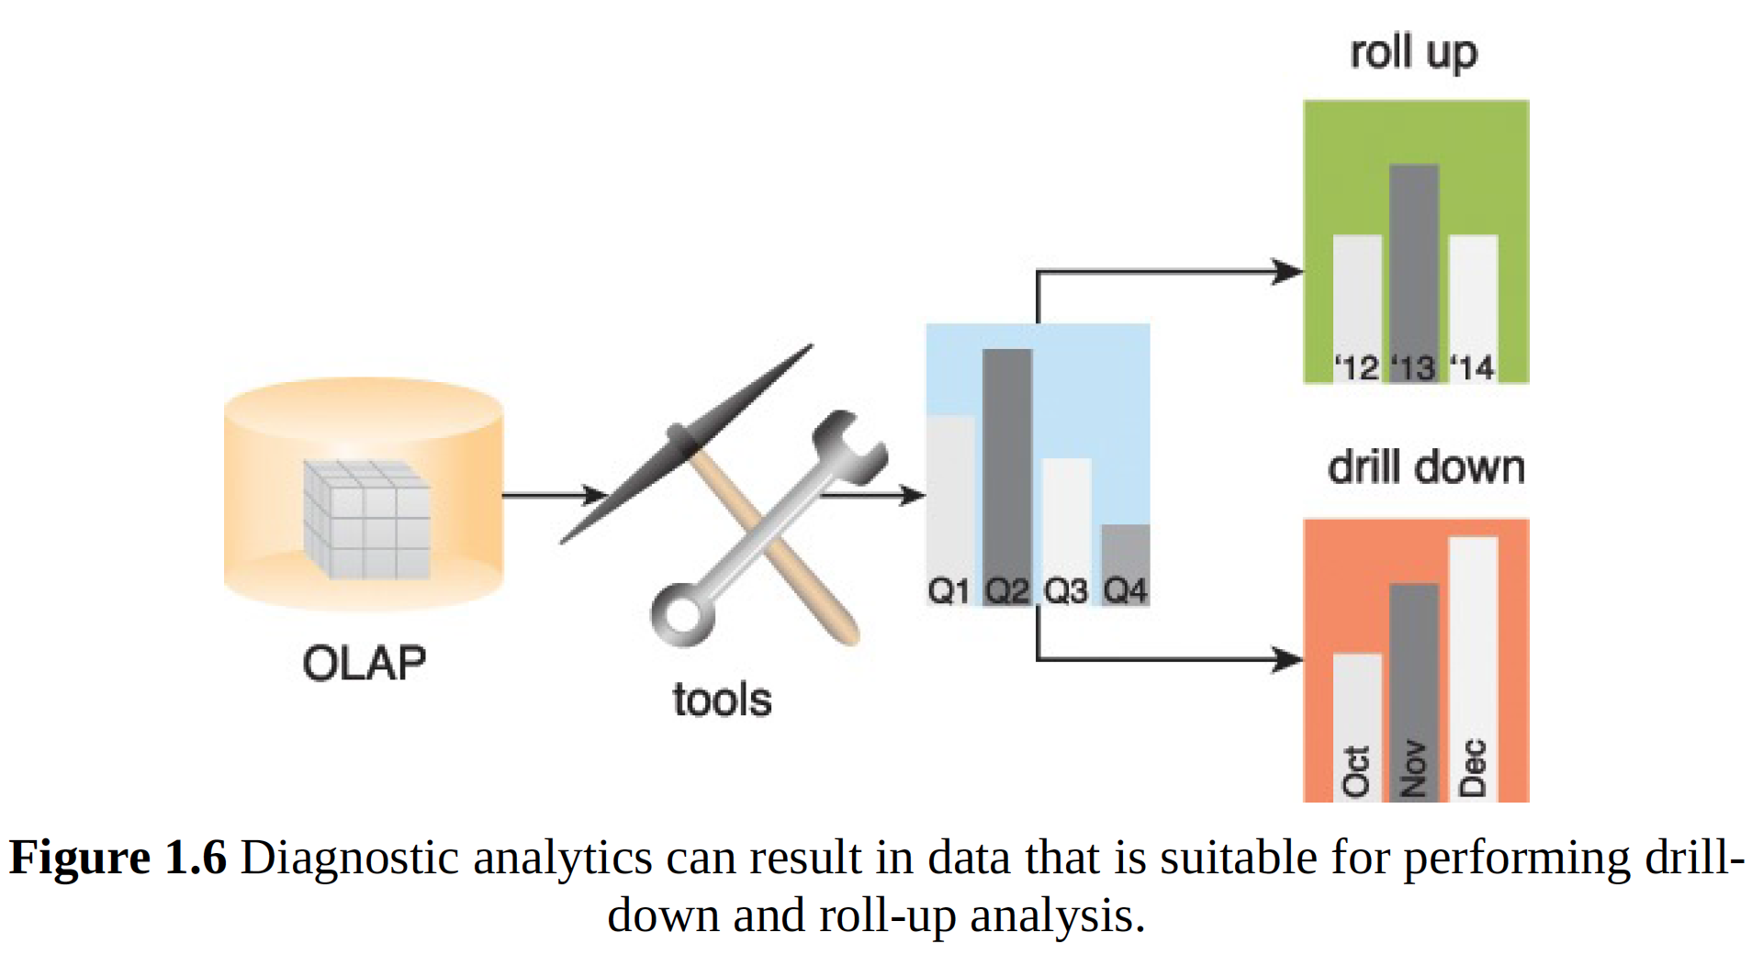
Concepts and Terminology
Diagnostic Analytics
Diagnostic analytics aim to determine the cause of a phenomenon that occurred in the past using questions that focus on the reason behind the event.
The goal of this type of analytics is to determine what information is related to the phenomenon in order to enable answering questions that seek to determine why something has occurred.
Erl, Thomas, Wajid Khattak, and Paul Buhler. Big data fundamentals: concepts, drivers & techniques. Prentice Hall Press, 2016.
Benjamin Harvey, Ph.D., EMSE 6992 – Introduction to Data Analytics

Slide 49
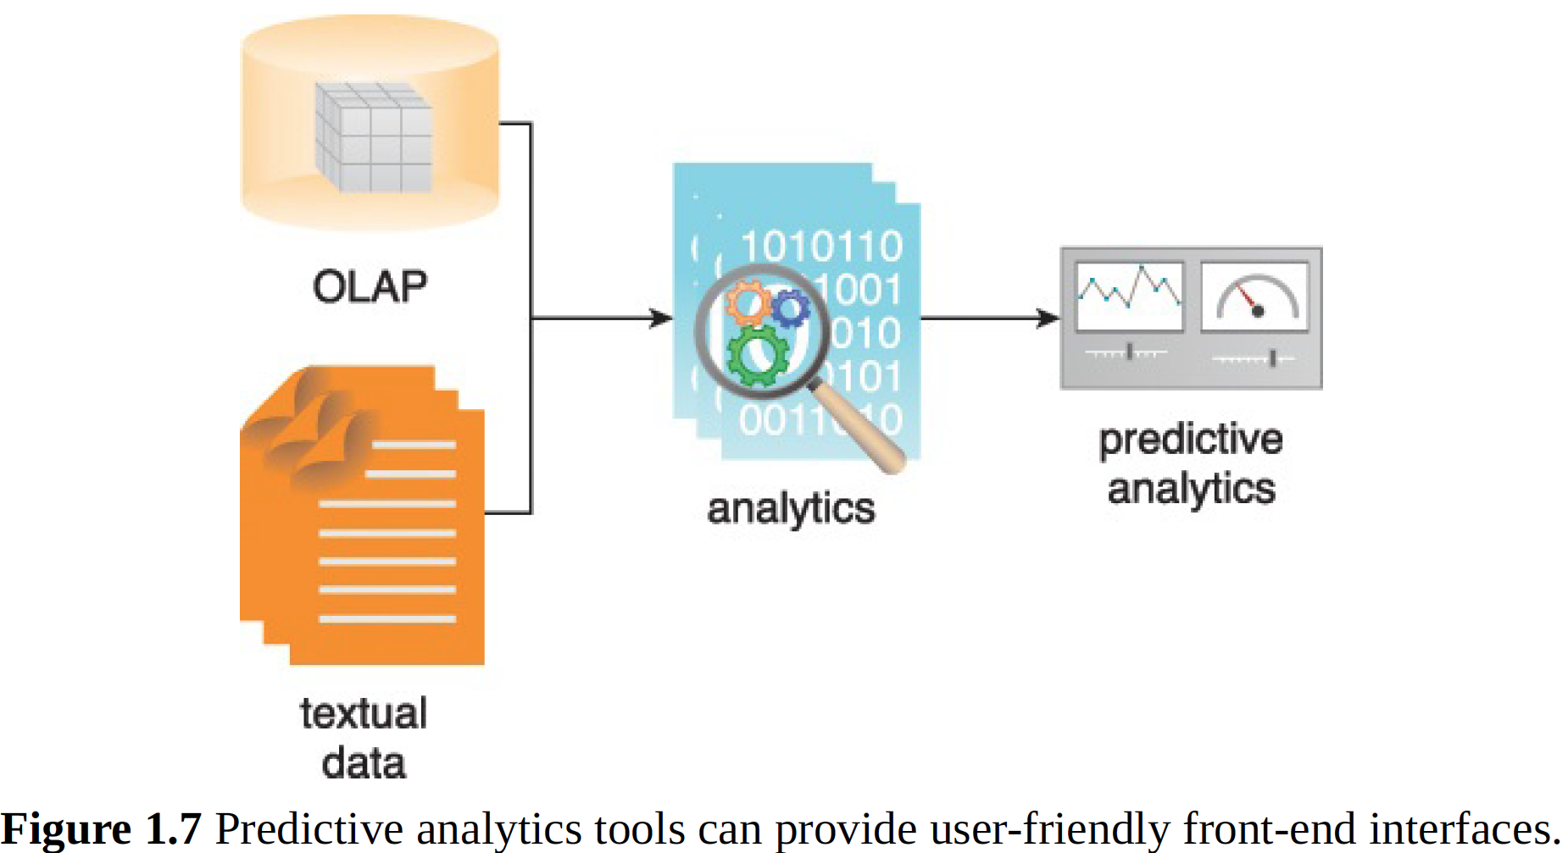
Concepts and Terminology
Predictive Analytics
Predictive analytics are carried out in an attempt to determine the outcome of an event that might occur in the future. Information is enhanced with meaning to generate knowledge that conveys how that information is related.
Erl, Thomas, Wajid Khattak, and Paul Buhler. Big data fundamentals: concepts, drivers & techniques. Prentice Hall Press, 2016.
Benjamin Harvey, Ph.D., EMSE 6992 – Introduction to Data Analytics

Slide 50

Concepts and Terminology
Prescriptive Analytics
Prescriptive analytics build upon the results of predictive analytics by prescribing actions that should be taken (best option and why).
Erl, Thomas, Wajid Khattak, and Paul Buhler. Big data fundamentals: concepts, drivers & techniques. Prentice Hall Press, 2016.
Benjamin Harvey, Ph.D., EMSE 6992 – Introduction to Data Analytics

Slide 51

Concepts and Terminology
Erl, Thomas, Wajid Khattak, and Paul Buhler. Big data fundamentals: concepts, drivers & techniques. Prentice Hall Press, 2016.
Benjamin Harvey, Ph.D., EMSE 6992 – Introduction to Data Analytics

Slide 52

Concepts and Terminology
Key Performance Indicators (KPI)
A KPI is a metric that can be used to gauge success within a particular business context.
KPIs are linked with an enterprise’s overall strategic goals and objectives.
They are often used to identify business performance problems and demonstrate regulatory compliance.
Business Intelligence (BI)
BI enables an organization to gain insight into the performance of an enterprise by analyzing data generated by its business processes and information systems.
The results of the analysis can be used by management to steer the business in an effort to correct detected issues or otherwise enhance organizational performance
Figure 1.9 BI can be used to improve business applications, consolidate data in data warehouses and analyze queries via a dashboard.
Erl, Thomas, Wajid Khattak, and Paul Buhler. Big data fundamentals: concepts, drivers & techniques. Prentice Hall Press, 2016.
Benjamin Harvey, Ph.D., EMSE 6992 – Introduction to Data Analytics

Slide 53


Concepts and Terminology
Structured Data
Structured data conforms to a data model or schema and is often stored in tabular form. It is used to capture relationships between different entities and is therefore most often stored in a relational database.
Semi-structured Data
Semi-structured data has a defined level of structure and consistency, but is not relational in nature. Instead, semi-structured data is hierarchical or graph-based.
Unstructured Data
Data that does not conform to a data model or data schema is known as unstructured data.
Metadata provides information about a dataset’s characteristics and structure.
Erl, Thomas, Wajid Khattak, and Paul Buhler. Big data fundamentals: concepts, drivers & techniques. Prentice Hall Press, 2016.
Benjamin Harvey, Ph.D., EMSE 6992 – Introduction to Data Analytics

Slide 54
Case Study: Ensure to Insure
Identifying Types of Data
The IT team members go through a categorization exercise of the various datasets that could be identified:
Categorize them as either: Structured, Unstructured and Semi-Structured
Identifying Data Characteristics
The IT team members want to gauge different datasets that are generated inside ETI’s boundary as well as any other data generated outside ETI’s boundary that may be of interest to the company in the context of volume, velocity, variety, veracity and value characteristics.
The team members take each characteristic in turn and discuss how different datasets manifest that characteristic.
Do you think the new Big Data strategy will work?
Benjamin Harvey, Ph.D., EMSE 6992 – Introduction to Data Analytics

